Slide 1

12 Slides
Case Study: F&B Flavors in North America (NA)
- Vinay H

Slide 2
TABLE OF CONTENT
1
Objective
4
Data Analysis & Visualization (Spreadsheet)
To brief about the case study: F&B Flavors in North America
Analysis data to get Insights & reporting
2
Approach
5
Detailed Findings
To brief about the approach undertaken to solve this case study
Top 10 emerging flavors & other insights in NA
3
Exploratory Data Analysis (EDA) & Preprocessing (Python)
6
Resources
EDA to understand the current state of data and preprocess it before analysis
To give a brief on analysis spreadsheets and python files developed

Slide 3
Objective:
Product Launch Info gives great insights on no of products across categories/demographics and tell us how we are performing today. Hence, having a keen eye on it is a key objective of every business.
We need to analyze product launces in North America to find top 10 emerging flavors and other insights.
Background
Our Mission
We got three excel sheets: Product Launch Dataset, Positioning Category Mapping Dataset and Flavor Classification Dataset
Any language/tools for data analysis.(I went with Python for EDA and preprocessing & further analysis and visualization in Excel).
Resources (provided)
Technologies

Slide 4


Approach:
NA Market Analysis in Excel
EDA & Preprocessing
Dataset
Preprocessed Dataset
Develop Visualization in Excel
Raw Data
Insights
EDA & Preprocessing – Python
NA Market Analysis – Excel spreadsheet
Visualization – Excel spreadsheet

Slide 5

Basic Stats
Total No of products (rows): 114689
Total No of Features (columns): 7
Total No of Market Subcategories: 14
Total No of Countries: 108
Total No of Regions: 8
Data Quality
Found Flavor & Positioning columns with NaNs
- 1976/114689 (0.02%) products have Flavor data missing
- 4312/114689 (0.04%) products have Positioning data missing
Exploratory Data Analysis & Preprocessing (Python)
Pre-processing
Decoupling Flavors from one cell to multiple rows
Decoupling Positioning Info from one cell to multiple rows
Compute Month & Year from launch data
To lower case conversion to solve data inconsistency
Striping leading & tailing spaces
Prepare Data
Add Flavor Group & Positioning Group info to pre-processed
data (from different data sets) via Joins
Data Quality checks
Stats After pre-processing:
- # of rows –> 505612
- # of columns –> 14

Slide 6
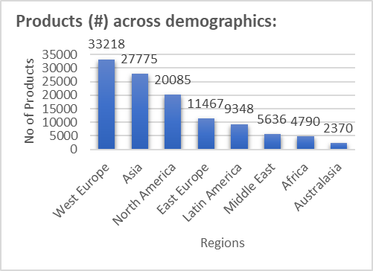
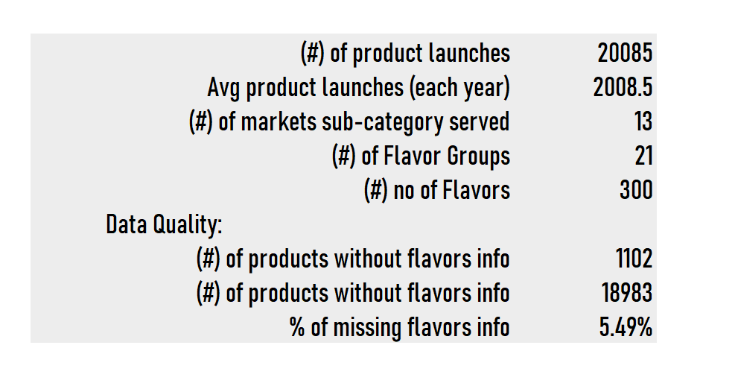
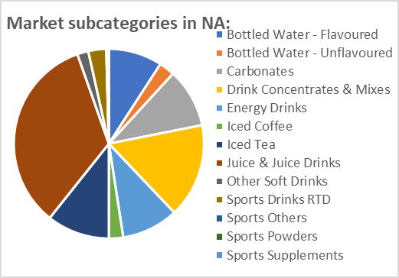
NA Market Analysis:
Basic Stats

Slide 7
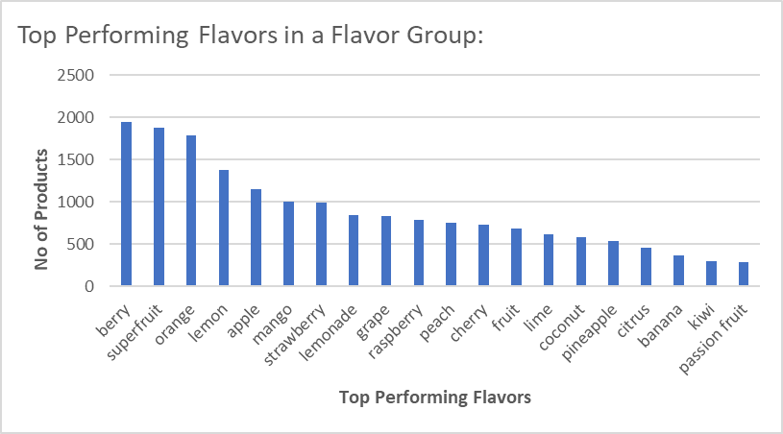
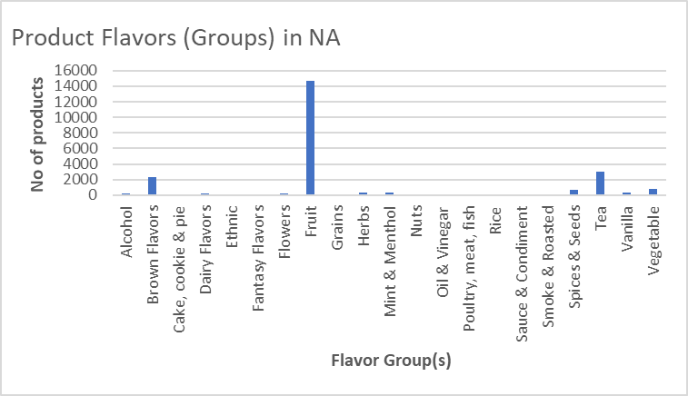
Flavor/Flavor Groups in NA:
Fruits:
Brown Flavors:

Slide 8
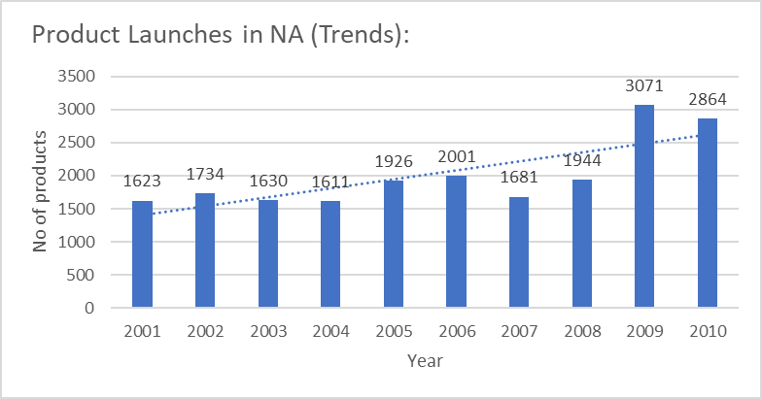
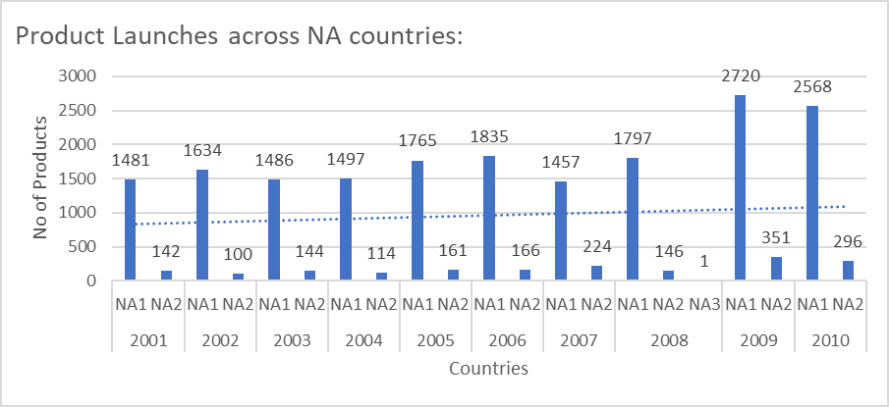
Trends (#Product Launches) in NA:

Slide 9
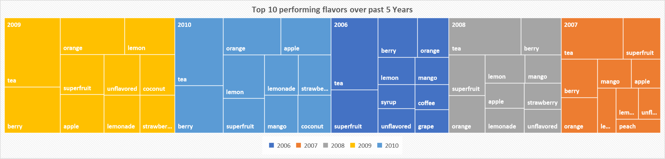
Top Performing Flavors over past 5 Years:

Slide 10
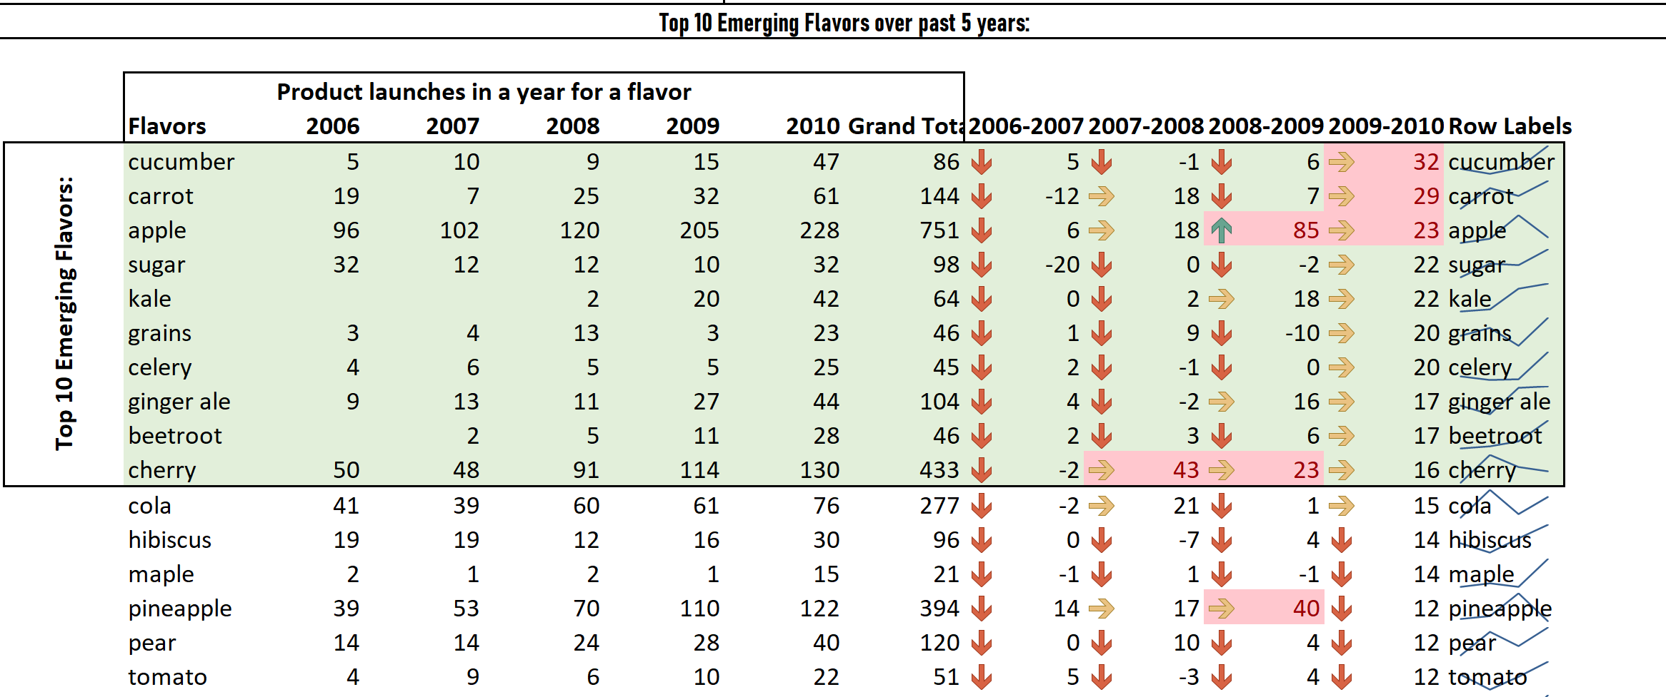
Top 10 Emerging Flavors over past 5 Years:

Slide 11
Resources:
Data Analysis Report:
Contains Assignment 1 & 2 and supporting analysis sheets
Data Analysis Report.xlsv
EDA & Preprocessing.ipynb
EDA & Preprocessing:
Contains Python Code for EDA & Preprocessing
Preprocessed Dataset:
Contains preprocessed Data
Final_preprocessed_data.csv

Slide 12
THANK YOU

